Slide 1
Presentation brief for MCT’s
Title of presentation | Run interactive queries using Azure Synapse Analytics serverless SQL pools
Presentation\Lab length | Presentation: 50 - 60 minutes Lab: 50 – 60 minutes
Audience | Data Engineers, Data Scientists, Data Professionals, Data Architects, BI Professionals, Developers
Purpose | Introduce Azure Synapse serverless SQL pools capabilities Query and manipulate data stored in a data lake using Azure Synapse serverless SQL pools Secure data and manage users in Azure Synapse serverless SQL pools
(think) Student key takeaways | The student should understand when it is best to make use of Azure Synapse serverless SQL pools The student should be able to query CSV, JSON and Parquet files stored in a data lake The student should create objects to help query data or optimize your existing data transformation pipeline through Azure Synapse serverless SQL pools in a secure way
(feel) Student desired mindset | The student may feel they understand the distinction between serverless and dedicated SQL pools The student may feel that with the information provided, it is easy to query files in a data The student may feel they have a clear understanding of the security layers involved
(do) Student outcomes | The student should be able to be able to query CSV, JSON The student should be able to create serverless SQL pool metadata objects to aid transformations The students should be able to understand when it is appropriate to use Azure Synapse serverless SQL pools
More information | For MCT course feedback, visit the Microsoft Official Courseware forum
Notes:
Instructor notes and guidance.
This slide is for MCT use only, outlining the aims and objectives of this module.

Slide 2
DP-203T00: Run interactive queries using Azure Synapse Analytics serverless SQL pools
Notes:
Instructor notes and guidance.
Introduce to the students that one of the common tasks of a data engineer is to perform exploratory data analysis. This enables them to understand the data within their data estate, and potentially perform ad hoc transformations to explore how the data can be used to serve the business.
Serverless SQL pools is an always available component of Azure Synapse Analytics that enables you to perform data engineering activities with no infrastructure setup required to perform these tasks. It is provisioned immediately after provisioning an Azure Synapse workspace, giving you the ability to query files that are stored in a data lake with minimal effort, and you only incur costs when the serverless SQL pools processes data. Share with students that this module will explore the capabilities that serverless SQL pools has, and how it can support various data engineering activities. They will also explore how they can query different file types such as CSV and Parquet, and how they can organize them into serverless SQL pool metadata objects so they can be consumed by other services and client applications. They will finish the module by understanding the security model that is implemented when working with data through serverless SQL pools in an Azure Data Lake, and how to work with this efficiently.
The lab is broken down into two exercises. Exercise one focuses on the first three module objectives where student will reinforce their learning by working in a serverless SQL pool, query data and creating metadata objects to shape the data from files stored in a data lake. Exercise two is exclusively focused on the security, showing the interaction of security at different levels from data lake security through to the security implements in Serverless SQL pools.

Slide 3
Agenda
Lesson 01: Explore Azure Synapse serverless SQL pools capabilities
Lesson 02: Query data in the lake using Azure Synapse serverless SQL pools
Lesson 03: Create metadata objects in Azure Synapse serverless SQL pools
Lesson 04: Secure data and manage users in Azure Synapse serverless SQL pools
Notes:
Instructor notes and guidance.
This space has been left deliberately blank

Slide 4
Lesson 01: Explore Azure Synapse serverless SQL pools capabilities
Notes:
Instructor notes
This space has been left deliberately blank

Slide 5
Azure Synapse serverless SQL Pools
Every Azure Synapse Analytics workspace comes with serverless SQL pool endpoints so you can start querying data in seconds to minutes in a data lake as soon as the workspace is created. There's no infrastructure to setup or clusters to maintain.
Notes:
Talking points
Every Azure Synapse Analytics workspace comes with serverless SQL pool endpoints that you can use to query data in the lake. Serverless SQL pool is a query service over the data in your data lake. It enables you to access your data through the following functionalities:
A familiar T-SQL syntax to query data in place without the need to copy or load data into a specialized store.
Integrated connectivity via the T-SQL interface that offers a wide range of business intelligence and ad-hoc querying tools, including the most popular drivers.
Serverless SQL pool is a distributed data processing system, built for large-scale data and computational functions. Serverless SQL pool enables you to analyze your Big Data in seconds to minutes, depending on the workload. Thanks to built-in query execution fault-tolerance, the system provides high reliability and success rates even for long-running queries involving large data sets.
Serverless SQL pool is serverless, hence there's no infrastructure to setup or clusters to maintain. A default endpoint for this service is provided within every Azure Synapse workspace, so you can start querying data as soon as the workspace is created.
There is no charge for resources reserved, you are only being charged for the data processed by queries you run, hence this model is a true pay-per-use model.
If you use Apache Spark for Azure Synapse in your data pipeline, for data preparation, cleansing or enrichment, you can query external Spark tables you've created in the process, directly from serverless SQL pool. Use Private Link to bring your serverless SQL pool endpoint into your managed workspace VNet.
Instructor notes and guidance.
Call out to students that Serverless SQL pools will enable you to explore files in a data lake immediately after provisioning Azure Synapse Analytics. This can provide a useful method for exploring the data that is stored within the data lake store that you have so that you can perform data discovery and exploratory data analysis
Recommended reading for this slide
https://docs.microsoft.com/en-us/learn/modules/explore-azure-synapse-serverless-sql-pools-capabilities/2-what-is

Slide 6
Comparing dedicated SQL Pools with serverless SQL pools in Azure Synapse Analytics
Dedicated SQL pools
Serverless SQL pools
Used for Data Warehouse operations
Provides predictable performance and costs
Reserves processing power for data stored in SQL tables
Used for data preparation or ad-hoc queries against unstructured data.
Provides an always available SQL endpoint for unplanned workloads
Enables interactive querying
Notes:
Talking points
Synapse SQL offers both serverless and dedicated resource models, offering consumption and billing options to fit your needs. For predictable performance and cost, provision dedicated SQL pools to reserve processing power for data stored in SQL tables. For unplanned or bursty workloads, use the serverless SQL pools.
Dedicated SQL pool (formerly SQL DW) represents a collection of analytic resources that are provisioned when using Synapse SQL. The size of a dedicated SQL pool (formerly SQL DW) is determined by Data Warehousing Units (DWU). Once your dedicated SQL pool is created, you can import big data with simple PolyBase T-SQL queries, and then use the power of the distributed query engine to run high-performance analytics. As you integrate and analyze the data, dedicated SQL pool (formerly SQL DW) will become the single version of truth your business can count on for faster and more robust insights.
Every Azure Synapse Analytics workspace comes with serverless SQL pool endpoints that you can use to query data in the Azure Data Lake (Parquet, Delta Lake, delimited text formats), Cosmos DB, or Dataverse. Serverless SQL pool is a query service over the data in your data lake. It enables you to access your data through the following functionalities:
A familiar T-SQL syntax to query data in place without the need to copy or load data into a specialized store.
Integrated connectivity via the T-SQL interface that offers a wide range of business intelligence and ad-hoc querying tools, including the most popular drivers.
Serverless SQL pool is a distributed data processing system, built for large-scale data and computational functions. Serverless SQL pool enables you to analyze your Big Data in seconds to minutes, depending on the workload. Thanks to built-in query execution fault-tolerance, the system provides high reliability and success rates even for long-running queries involving large data sets.
Instructor notes and guidance.
It is important that students understand the distinction between these two modules before continuing with the content in this module
Recommended reading for this slide
https://docs.microsoft.com/en-us/learn/modules/explore-azure-synapse-serverless-sql-pools-capabilities/3-when-use

Slide 7
Explore Azure Synapse serverless SQL pools capabilities
Every Azure Synapse Analytics workspace comes with serverless SQL pool endpoints so you can start querying data in seconds to minutes in a data lake as soon as the workspace is created. There's no infrastructure to setup or clusters to maintain.
Data Exploration
Data transformation
Logical data warehouse
Browse the data lake and get initial insights about the data. Using Azure Synapse Studio, you can explore the data both graphically and programmatically.
Serverless SQL pool enables you to execute transformation statements over the data in the lake and store the results back to the data lake in a specified file format.
Create objects (such as VIEWs and External Tables) that provide you with a SQL metadata layer over the data in the lake to create a logical data warehouse. Once these objects are created, any tool that can connect to serverless SQL pool will see these objects as regular SQL Server objects
Notes:
Talking points
Every Azure Synapse Analytics workspace comes with a built in serverless SQL pool endpoint that you can be used to query files in a data lake. It enables you to access your data through the following functionalities:
A familiar T-SQL syntax to query data in place without the need to copy or load data into a specialized store.
Integrated connectivity via the T-SQL interface that offers a wide range of business intelligence and ad-hoc querying tools, including the most popular drivers.
Serverless SQL pool is a distributed data processing system, built for large-scale data and computational functions.
Serverless SQL pool enables you to analyze your Big Data in seconds to minutes, depending on the workload.
Thanks to built-in query execution fault-tolerance, the system provides high reliability and success rates even for long-running queries involving large data sets.
Serverless SQL pool is serverless, hence there's no infrastructure to setup or clusters to maintain. A default endpoint for this service is provided within every Azure Synapse workspace, so you can start querying data as soon as the workspace is created. There is no charge for resources reserved, you are only being charged for the data processed by queries you run; hence this model is a true pay-per-use model.
If you use Apache Spark for Azure Synapse in your data pipeline, for data preparation, cleansing or enrichment, you can query external Spark tables you've created in the process, directly from serverless SQL pool. Use Private Link to bring your serverless SQL pool endpoint into your managed workspace VNet.
Instructor notes and guidance.
Reiterate to the students that a serverless SQL pool is created just by provisioning an Azure Synapse Workspace. Its benefit is that it enables organizations to explore the data, build logical data warehouse and test out transformations at minimum cost. This is important as it allows business to explore the potential for building data warehouse without the upfront cost, and only pay for the data that you consume in doing this work. Exercise 1 of the lab provides the opportunity to explore how you can explore the data
Recommended reading for this slide
https://docs.microsoft.com/en-us/learn/modules/explore-azure-synapse-serverless-sql-pools-capabilities/4-use-cases

Slide 8
Lesson 01: Query data in the lake using Azure Synapse serverless SQL pools
Notes:
Instructor notes
This space has been left deliberately blank

Slide 9
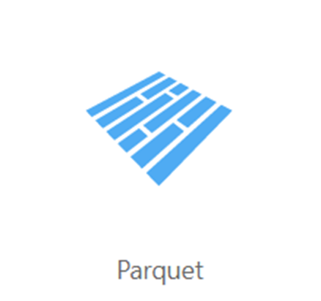
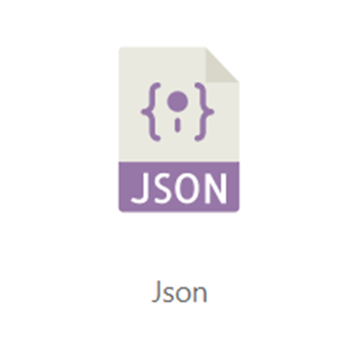
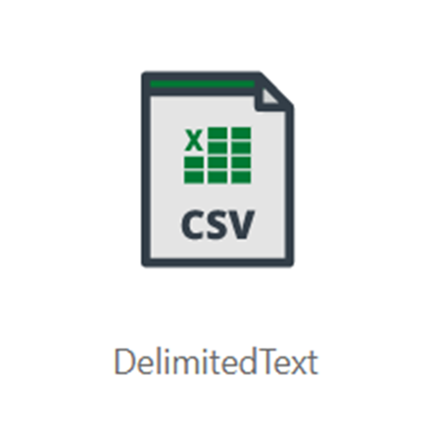
Common files to query
Notes:
Talking points
Serverless SQL pool enables you to query data in your data lake. It offers a T-SQL query surface area that accommodates semi-structured and unstructured data queries. For querying, the following T-SQL aspects are supported:
- Full SELECT surface area, including majority of SQL functions and operators.
- CREATE EXTERNAL TABLE AS SELECT (CETAS) creates an external table and then exports, in parallel, the results of a Transact-SQL SELECT statement to Azure Storage.
To support a smooth experience for in place querying of data that's located in Azure Storage files, serverless SQL pool uses the OPENROWSET function with additional capabilities:
- Query multiple files or folders
- PARQUET file format
- Query CSV and delimited text (field terminator, row terminator, escape char)
- Read a chosen subset of columns
- Schema inference
- filename function
- filepath function
- Work with complex types and nested or repeated data structures
Instructor notes and guidance.
The variety of files that are supported makes using serverless SQL pools a compelling feature of Azure Synapse Analytics to use to explore data held within a data lake. This is further compounded by the fact that you only pay for the data that you query.
Recommended reading for this slide
https://docs.microsoft.com/en-us/learn/modules/query-data-lake-using-azure-synapse-serverless-sql-pools/

Slide 10
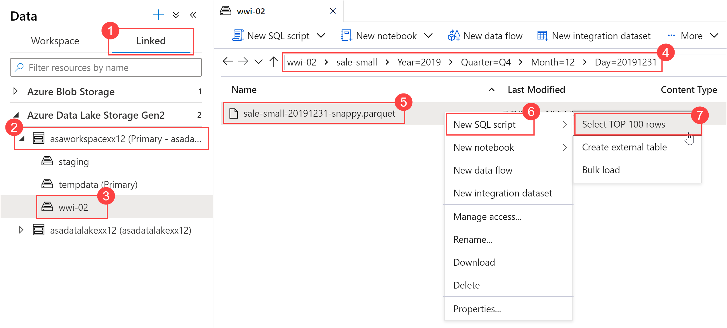
Using Azure Synapse Studio to view data
Notes:
Talking points
A good starting point to browse the data in the files in a data lake is to use the ‘Select Top 100 rows’ feature within Azure Synapse Studio. This will generate a script that returns the data that can be used as starting point for exploratory data analysis
Instructor notes and guidance.
To perform the steps shown in the screenshot
In Synapse Studio, navigate to the Data hub.
Select the Linked tab (1) and expand Azure Data Lake Storage Gen2 (2). Expand the primary ADLS Gen2 account and select the container (3). Navigate to the folder (4), and right-click on the parquet file (5), select New SQL script (6), then Select TOP 100 rows.
Recommended reading for this slide
https://docs.microsoft.com/en-us/learn/modules/serve-data-from-azure-synapse-serverless-sql-pool/2-use-synapse-studio-analyze-visualize-data-via

Slide 11
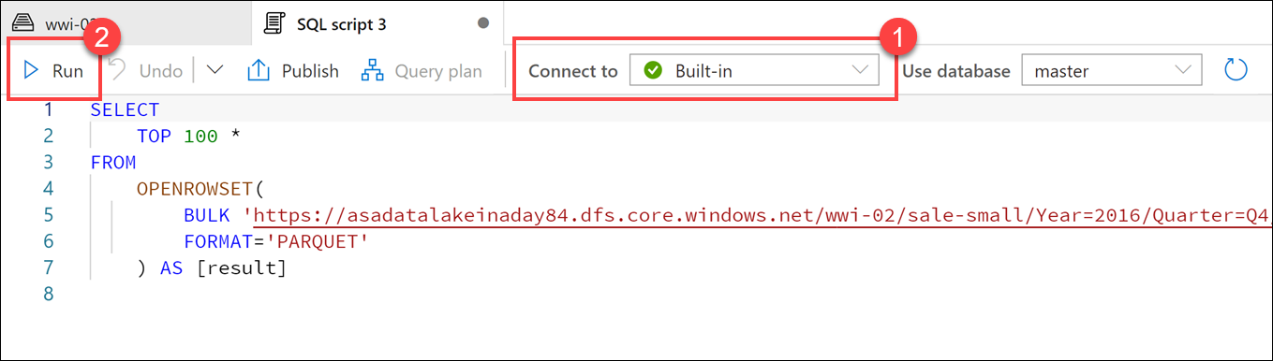
Querying parquet files in a data lake
Notes:
Talking points
Understanding data through data exploration is one of the core challenges faced today by data engineers and data scientists as well. Depending on the underlying structure of the data as well as the specific requirements of the exploration process, different data processing engines will offer varying degrees of performance, complexity, and flexibility.
In Azure Synapse Analytics, you can use either SQL, Apache Spark for Synapse, or both. Which service you use mostly depends on your personal preference and expertise. When conducting data engineering tasks, both options can be equally valid in many cases. However, there are certain situations where harnessing the power of Apache Spark can help you overcome problems with the source data. This is because in a Synapse Notebook, you can import from a large number of free libraries that add functionality to your environment when working with data. There are other situations where it is much more convenient and faster using serverless SQL pool to explore the data, or to expose data in the data lake through a SQL view that can be accessed from external tools, like Power BI
As per the screenshot in the slide, Ensure Built-in is selected (1) in the Connect to dropdown list above the query window, then run the query (2). Data is loaded by the serverless SQL endpoint and processed as if was coming from any regular relational database. You can then modify the code to perform more data analysis using a familiar T-SQL language construct
Instructor notes and guidance.
Use the recommended reading below to view example of the type of queries that can be used to explore and manipulate data within a parquet file
Recommended reading for this slide
https://docs.microsoft.com/en-us/learn/modules/query-data-lake-using-azure-synapse-serverless-sql-pools/3-query-parquet-file

Slide 12
Lesson 01: Create metadata objects in Azure Synapse serverless SQL pools
Notes:
Instructor notes
This space has been left deliberately blank

Slide 13
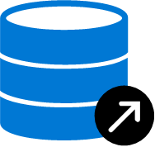



Create metadata objects in Azure Synapse serverless SQL pools
CREATE DATABASE [YourDatabaseName]
Database
CREATE DATABASE SCOPED CREDENTIAL [sqlondemand]
WITH IDENTITY='SHARED ACCESS SIGNATURE',
SECRET = 'sv=2018-03-28&ss=bf&srt=sco&sp=rl&'
Database
scoped credential
CREATE EXTERNAL DATA SOURCE SqlOnDemandDemo WITH (
LOCATION = 'https://sqlondemandstorage.blob.core.windows.net',
CREDENTIAL = sqlondemand );
External data source
CREATE EXTERNAL FILE FORMAT QuotedCsvWithHeaderFormat
WITH
( FORMAT_TYPE = DELIMITEDTEXT,
FORMAT_OPTIONS ( FIELD_TERMINATOR = ',', STRING_DELIMITER = '"', FIRST_ROW = 2 ) );
External file format
CREATE EXTERNAL TABLE populationExternalTable
( [country_name] VARCHAR (100) COLLATE Latin1_General_BIN2,
[year] smallint, [population] bigint )
WITH
( LOCATION = 'csv/population/population.csv’,
DATA_SOURCE = sqlondemanddemo,
FILE_FORMAT = QuotedCSVWithHeaderFormat );
External Table
Notes:
Talking points
Metadata objects helps you query data or optimize your existing data transformation pipeline through Azure Synapse serverless SQL pools. It also enables clients connecting to the serverless SQL pool to discover the objects to query the data in the lake. This essentially creates a semantic layer over which tools like Power BI can use to easily consume the data. You should start of by creating a database, and then you can create the following objects to organise the data so that it can be accessed securely:
Database scoped credential
External data source
External file formats
External tables
Views
Instructor notes and guidance.
Metadata objects can help you simplify understanding the data that is held in the files of a data lake by enabling you to define a semantic layer on top of the files. This initial step can also simplify the transformation that you may use against the data as it can be presented as tables in the serverless SQL pool.
The ability to create metadata objects within a serverless SQL pools in Azure Synapse Analytics provides some opportunities for customers to use it as a proof-of-concept layer for any potential enterprise data warehouses that they may consider creating. It is important to note; however, that it is better to transition the proof of concept to a dedicated SQL pools where the data and resources are persisted should the proof-of-concept be a success, and the decision is made to make the enterprise data warehouse more permanent.
This is a build slide, you should talk through each animation, begin by talking about the pre-requisite of creating a database within the serverless SQL pool so that the metadata objects can be stored
Click 1 – Create Database Scoped Credential. This is required to provide access to external objects such as a blob store. You are required to define an identity that is allowed to access the data store. In the code example shown, this is a shared access signature with its secret defined
Click 2 – Create External Data Source. This provides the connection information to the data store in the form of a URL, and also makes reference to the database scoped credential that is used to authenticate access to the data store.
Click 3 – Create External File Format. This provides information pertaining to the format of the files that will be accessed within the data store
Click 4 – Create External Table. This contains the table definition in which the data from a file will be loaded into. Within the definition the data source parameter points to the name of the Create External Data Source you have defined, and the File_Format parameter points to the name of the Create External File Format you have defined.
Recommended reading for this slide
https://docs.microsoft.com/en-us/learn/modules/create-metadata-objects-azure-synapse-serverless-sql-pools/

Slide 14
Lesson 01: Secure data and manage users in Azure Synapse serverless SQL pools
Notes:
Instructor notes
This space has been left deliberately blank

Slide 15

Securing access to data in a data lake when using Azure Synapse Analytics
Authentication
Authorization
Access to storage accounts
Notes:
Talking Points:
There are three areas of consideration when working with security in Azure Synapse Analytics serverless SQL pools.
Authentication
Authentication is the process of proving the user is who they claim to be. A user connects to a database using a user account. When a user attempts to connect to a database, they provide a user account and authentication information.
Authorization
Authorization refers to the permissions assigned to a user and determines what that user is allowed to do.
Access to storage account
As this service is querying files that are stored in the data lake, there also has to be consideration for data lake security as well as Azure Synapse Analytics security.
Instructor notes and guidance.
It’s important to point out the two layers of security here. The security that is provided at the serverless SQL pool level, and then the security that occur on the storage account in the data lake
Recommended reading for this slide
https://docs.microsoft.com/en-us/learn/modules/secure-data-manage-users-azure-synapse-serverless-sql-pools/

Slide 16



Choose an authentication method
Azure Synapse Analytics dedicated SQL pool
Azure Data Lake Store
Authentication options
SQL Authentication
Or
Azure Active Directory Authentication
Authentication options
Anonymous access
Shared access signature
Managed identity
User identity
Notes:
Talking Points:
There are 3 areas of security to be aware of with Azure Synapse serverless SQL pools
Dedicated SQL pool authentication
SQL authentication.
With this authentication method, the user submits a user account name and associated password to establish a connection. This password is stored in the master database for user accounts linked to a login or stored in the database containing the user accounts not linked to a login.
A login is an individual account in the master database, to which a user account in one or more databases can be linked. With a login, the credential information for the user account is stored with the login.
A user account is an individual account in any database that may be, but does not have to be, linked to a login. With a user account that is not linked to a login, the credential information is stored with the user account.
Azure Active Directory Authentication
With this authentication method, the user submits a user account name and requests that the service use the credential information stored in Azure Active Directory (Azure AD).
Storage account authentication
Storage account access
A user that is logged into the serverless SQL pool service must be authorized to access and query the files in Azure Storage. serverless SQL pool supports the following authorization types:
Anonymous access
Shared access signature (SAS)
Managed Identity.
User Identity
Instructor notes and guidance.
It’s important to delineate that a user must be authenticated at the dedicated SQL pool first, and then there has to be an authentication mechanism to the data lake store
Recommended reading for this slide
https://docs.microsoft.com/en-us/learn/modules/secure-data-manage-users-azure-synapse-serverless-sql-pools/2-choose-authentication-method

Slide 17

Manage users in Azure Synapse serverless SQL pools
User
Bob
Role assignment
Storage Blob Data Reader
Storage account name
asadatalakeinaday84
Notes:
Talking Points:
Authorization to access data and perform various actions are managed using roles and permissions. Authorization refers to the permissions assigned to a user and determines what that user is allowed to do. Authorization is controlled by your user account's database role memberships and object-level permissions. As a best practice, you should grant users the least privileges necessary, by making use of any built in roles where possible
Instructor notes and guidance.
Share with the students that the second part of the lab will explore authentication and authorization with a working example that will be tested. It is also important to note that if the students are performing this on a work account, it is highly likely that they will not be able to conduct this part of the lab due to corporate IT policies that will likely prevent this. If you use a Microsoft account (e.g. an outlook.com or Hotmail.com account) this will work.
It does cement the point that the security aspect is managed by multiple IT professionals, and that it is not the domain of one role.
Recommended reading for this slide
https://docs.microsoft.com/en-us/learn/modules/secure-data-manage-users-azure-synapse-serverless-sql-pools/3-manage-users

Slide 18
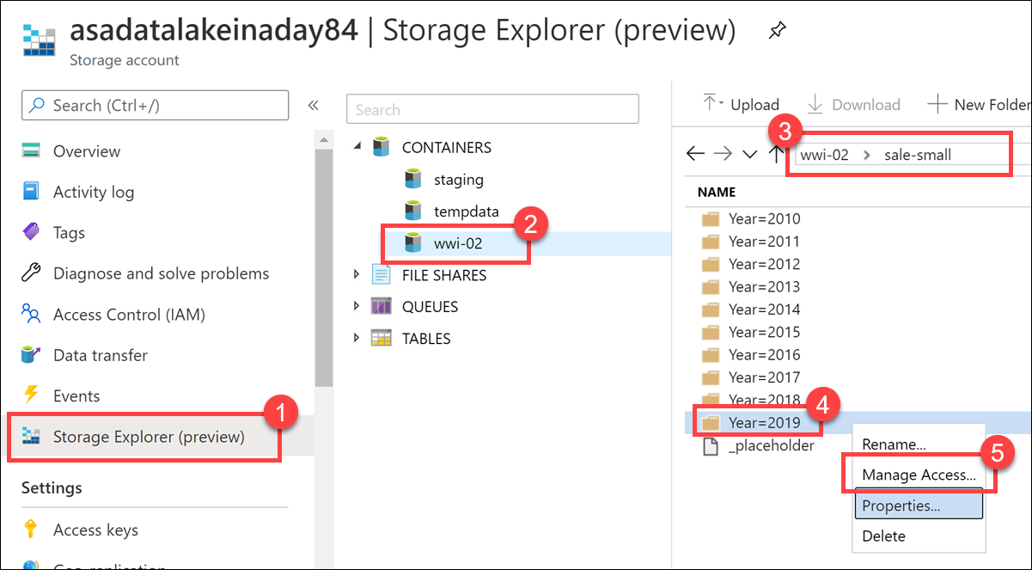
Manage user access to data lake files
Notes:
Talking Points:
Control to the individual folders and files can also be controlled within the storage account itself by using Access Control (IAM) settings. In the example in the graphic, you can access this via the following steps:
Select Storage Explorer (preview) on the left-hand menu (1). Expand CONTAINERS and select the wwi-02 container (2). Open the sale-small folder (3), right-click on the Year=2019 folder (4), then select Manage Access.. (5).
Should you wish to store the data in a metadata object such as a database view that is stored in a database in a serverless SQL pool, then you also have to set permission on the database view to allow access to the view too.
Instructor notes and guidance.
The graphic is showing how to control access to the files in the data lake.
Recommended reading for this slide
For data lake access
https://docs.microsoft.com/en-us/learn/modules/secure-azure-storage-account/
For serverless SQL pool metadata object access
https://docs.microsoft.com/en-us/learn/modules/secure-data-manage-users-azure-synapse-serverless-sql-pools/4-manage-user-permissions

Slide 19
Review questions
Q01 – Which SQL function enables you to access files in Azure storage and read the contents of a remote data source?
A01 – OPENROWSET
Q02 – Which metadata object allows you to reuse the queries that you create and enable applications to view data in a serverless SQL pool?
A02 – Views
Q03 – Name the three permissions that can be set on a container object?
A03 – Read, write and execute
Notes:
Instructor notes and guidance.
This space has been left deliberately blank

Slide 20
Lab: Run interactive queries using Azure Synapse Analytics serverless SQL pools
Notes:
Instructor notes and guidance.
This space has been left deliberately blank

Slide 21
Lab overview
In this lab, students will learn how to work with files stored in the data lake and external file sources, through T-SQL statements executed by a serverless SQL pool in Azure Synapse Analytics. Students will query Parquet files stored in a data lake, as well as CSV files stored in an external data store. Next, they will create Azure Active Directory security groups and enforce access to files in the data lake through Role-Based Access Control (RBAC) and Access Control Lists (ACLs).
Lab objectives
After completing this lab, you will be able to:
Querying a Data Lake Store using serverless SQL pools in Azure Synapse Analytics
Securing access to data through using a serverless SQL pool in Azure Synapse Analytics
Notes:
Instructor notes and guidance.
In exercise 1 of this lab, it is very likely that many of your students will be very comfortable with the various SQL query statements that they have learned during this module. If your students are familiar with PolyBase, they will find the external table content familiar territory too. To that end, you may find yourself focusing on the importance of the OPENROWSET function to enable access to the files in a data lake. You may also find that you are supporting the students in the class that have never seen the SQL programming language before. To that end, the lab also shows how a person can script out the code using the GUI, which also cements the perspective that this capability is open to business users and data analysts to explore the data.
In exercise 2, the students will look at the various options that are available to Securing access to data through using a serverless SQL pool in Azure Synapse Analytics. The students will explore the creation of Active Directory security groups, and how to add member to the group. They will configure data lake security using Role-Based Access Control (RBAC) and Access Control Lists (ACLs) and test the access to the files once this has been configured. It is important to call out to the students that it may be the case that they do not perform this work back in their own organizations, and that they would have to work with Azure Active Directory Administrators to set this up.

Slide 22











Lab 04 Overview
asacosmosdb<unique_suffix>
CosmosDB
Campaign Info
Azure Databricks
asagadatalake<unique_suffix>
Cluster
Azure Data Lake
wwi-02
Sales (parquet)
Customer (csv)
dp203sql<unique_suffix>
SourceDB
Synapse Analytics
Dedicated SQL Pool (SQLPool1)
Built-In Serverless SQL Pool
Apache Spark pool
Pipelines and Dataflows
Power BI
asagaworkspace<unique_suffix>
Notes:
This slide is an optional slide that you can use to show a high-level overview of the technologies used in the lab.
In this lab, students will learn how to work with files stored in the data lake and external file sources, through T-SQL statements executed by a serverless SQL pool in Azure Synapse Analytics. Students will query Parquet files stored in a data lake, as well as CSV files stored in an external data store. Next, they will create Azure Active Directory security groups and enforce access to files in the data lake through Role-Based Access Control (RBAC) and Access Control Lists (ACLs).

Slide 23
Lab review
Question 1 – Where in Azure Synapse Studio, can you Select TOP 100 rows of data stored in a data lake?
Question 2 – When scripting an External table using the “Create external table” GUI method in Synapse Studio, what metadata objects are created?
Question 3 – Which CREDENTIAL identity type can be time limited?
Question 4 – Which role enables a user to create external table as select (CETAS) against an Azure Data Lake Gen2 data store
Notes:
Answers
Question 1 - Open Synapse Studio (https://web.azuresynapse.net/), and then navigate to the Data hub. Select the Linked tab and expand Azure Data Lake Storage Gen2. Expand the account and container, and then navigate to the folder where the data is stored. Right-click on the file, select New SQL script, then Select TOP 100 rows.
Question 2 – When creating an External table using the “Create external table” GUI method in Azure Synapse Studio, the following metadata objects are scripted
1. External table
2. External file format
3. External data source
Question 3 – A Shared Access Signature is the CREDENTIAL identity type can be time limited
Question 4 – The Storage Blob Data Contributor role enables a user to create external table as select (CETAS) against an Azure Data Lake Gen2 data store

Slide 24
Module summary
In this module, you have learned about:
Explore Azure Synapse serverless SQL pools capabilities
Query data in the lake using Azure Synapse serverless SQL pools
Create metadata objects in Azure Synapse serverless SQL pools
Secure data and manage users in Azure Synapse serverless SQL pools
Next steps
After the course, consider reading the documentation on the best practices for serverless SQL pool in Azure Synapse Analytics
Notes:
Instructor notes and guidance.
The next steps is suggested post course learning materials to reinforce what they have learned in the module.

Slide 25
Closing slide
Notes:
Instructor notes and guidance.
This space has been left deliberately blank

